Slide 1


DoubtMate
*Solving your doubts like a buddy who always has the right answers!*

Slide 2
Abstract
DoubtMate is an online platform designed to help students
Clear their doubts and share knowledge with peers and teachers.
It fosters a collaborative learning environment where questions
Can be posted and answered by anyone in the community.

Slide 3



Existing System
Existing online platforms such as general-purpose forums or social media groups are not always academic-focused, and do not offer structured guidance from teachers, like Facebook Study Groups
Existing platforms that focus on only specific features like question-answers or video lectures, and are often paid services , like DoubtNut and Vedantu

Slide 4

Technologies used
Frontend:
HTML
CSS
JavaScript
Backend:
Firebase
Jitsi API
Content Moderation API
Database:
Firebase Firestore
Firebase Strorage

Slide 5
Key Features
Q&A Platform for Students and Teachers
Note Sharing Functionality
Upvote/ Downvote System for Questions
Private Study Groups for Collaboration with Live Video Lecture
Admin Management and Moderation Tools

Slide 6



Peer and Teacher collaboration

Slide 7
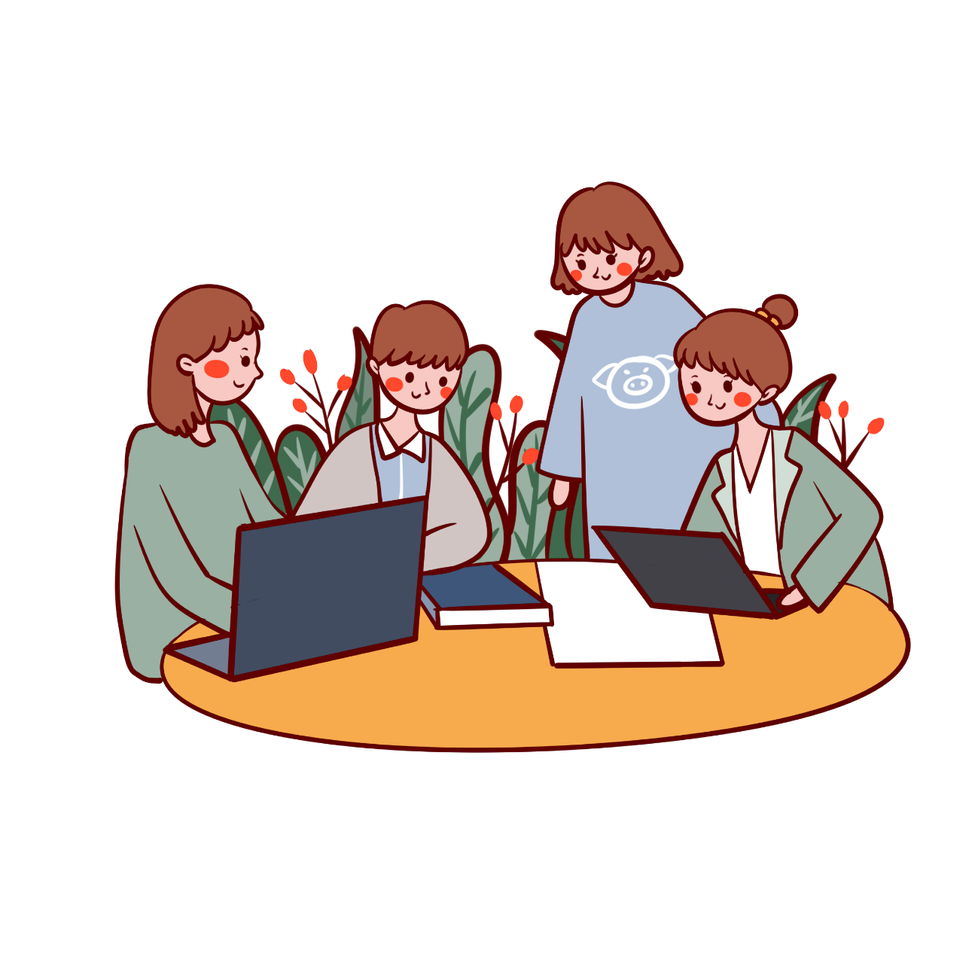
Private Study Group
Students can have a group discussion or study session without any physical boundaries
Teacher can have a doubt session with the students
Students can share their notes of study material within the study group

Slide 8
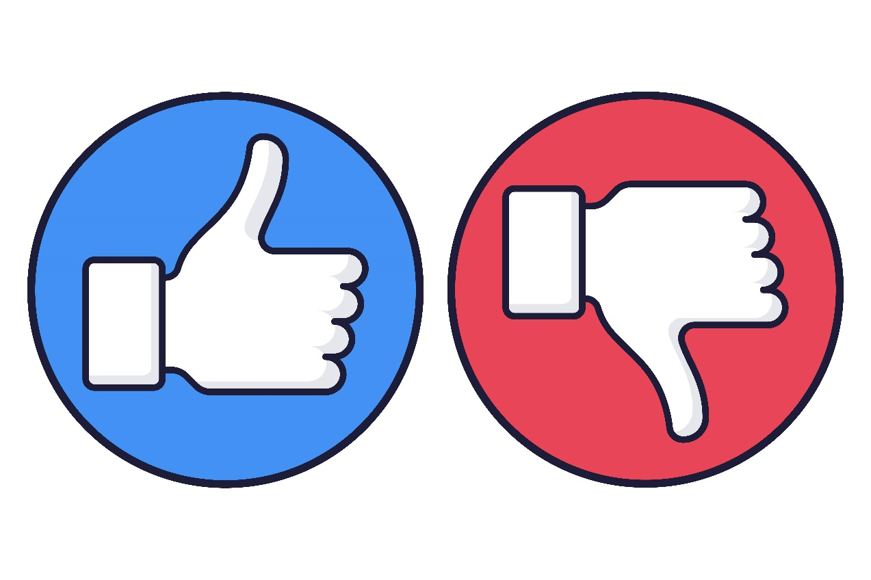
Upvote and Downvote
Upvote and Downvote enables user to vote the content posted and it can reflect the authenticity of the content

Slide 9

Live Video Conference
The Teachers can host a lecture or a doubt session for students

Slide 10
Conclusion
DoubtMate is a free, collaborative platform designed to streamline
student-teacher interactions through features like question-answering,
video uploads, and note sharing.
By integrating real-time updates, private study groups, and advanced moderation,
it fosters a safe and engaging learning environment.
Scalable to fit department or college needs,
DoubtMate promotes open knowledge sharing,
making education accessible and interactive for all users.

